Slide 1


REVIEWING TLI ROUTINES
& STRATEGIES 2014
Elementary Grades 1 - 5
Presented by TLI Teacher Specialists:
Bertha Elizondo, Martha Galvan, Judith Gavito,
Cristina Tijerina , Maire Vera, & Leonila Garcia
Notes:
This is a review of the Texas Literacy Initiative Routines & Strategies that have been presented to the teachers over the past two years. These routines and strategies are research-based practices that will enhance the literacy instruction in your classrooms.

Slide 2
Planning for Sustainability
The TLI grant offers trainings on 10 comprehension modules. These modules provide teachers with research-based knowledge & teaching practices to offer direct, explicit, systematic instruction of comprehension across the grade levels.
Instructional Supports | Strategy Focus
Reading With Purpose (K-12) | Making Connections (K-12)
Think-Turn-Talk (K-12) | Creating Mental Images (K-5)
Cognitive Strategy Routine (K-12) | Making Inferences & Predictions (K-12) (Two Parts Grades 6-12 only)
 | Determining Importance & Summarizing (K-12) (Four Parts Grades 3-12)
Listening Comprehension (PK-1) | Asking & Answering Questions (K-12)
 | Monitoring & Clarifying (Multiple Strategy Use) (K-12)
Notes:
Planning for Sustainability
The focus for the 2014-2015 school year will be to refine the use & implementation with fidelity of the previously introduced TLI routines and strategies.

Slide 3
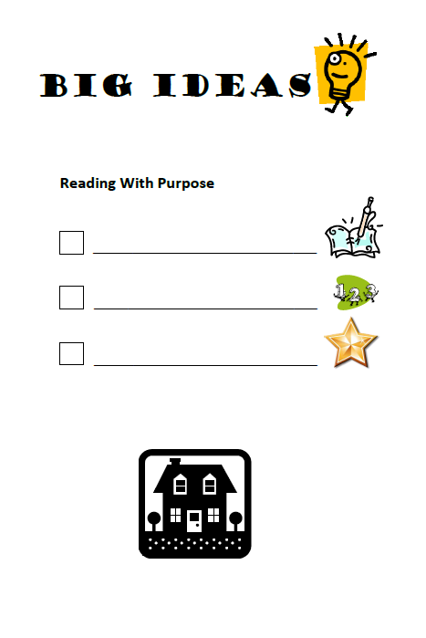
Reading with Purpose (PK – 5th)
Track your thinking
CPQ for each reading
Good to Great!
Notes:
Refer to the ELAR/SLAR Instructional Guide provided for HMH Kinder to 5th grade CPQ and TTT questions.
The Comprehension Purpose Question is a type of question which is used to scaffold students’ comprehension of text.

Slide 4
Setting a CPQ
Step 1: Record Thinking While Reading
Step 2: Brainstorm possible CPQs
Step 3: Integrate With Teacher Resources if Available
Step 4: Select Great CPQs
Step 5: Select a CPQ for First, Second, or Third Reading
Notes:
These are the steps to create great CPQs. (Read steps and clarify.)
The purpose of setting CPQs is to guide students’ thinking so that they deepen and extend their understanding.

Slide 5
CPQs : Going From Good to Great!
A good CPQ:
A great CPQ:
Is answered in the text either directly or indirectly
Involves some student thinking
Will focus on comprehension
Relates to student learning
Cannot be completely answered until students have read the entire text
Involves higher order thinking, inferences, and text evidence
Will deepen and extend comprehension
Relates to the comprehension strategy currently being taught
Notes:
We try to link the CPQ to the strategy focus for the lesson.
For example, if we’re focusing on making connections, then we set a CPQ that will guide students to understand the character through the connections that they make.

Slide 6
First Reading? Second Reading? Third Reading?
Step 5: Select a CPQ for each reading
First reading: Focus on the story as a whole. (Ex: What do we learn about Beth and Molly?)
Second reading: Deepen understanding.
(Ex: What are the different ways that each girl shows courage?)
Third reading and beyond: Deepen and extend understanding. (Ex: What does the story teach us about courage and friendship?)
Notes:
Setting increasingly more complex CPQs for a particular reading will deepen and extend the students’ understanding and more closely connect to the rigor of STAAR and higher order thinking.

Slide 7
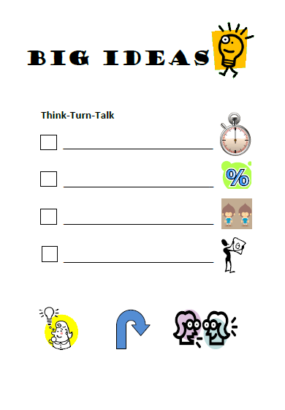
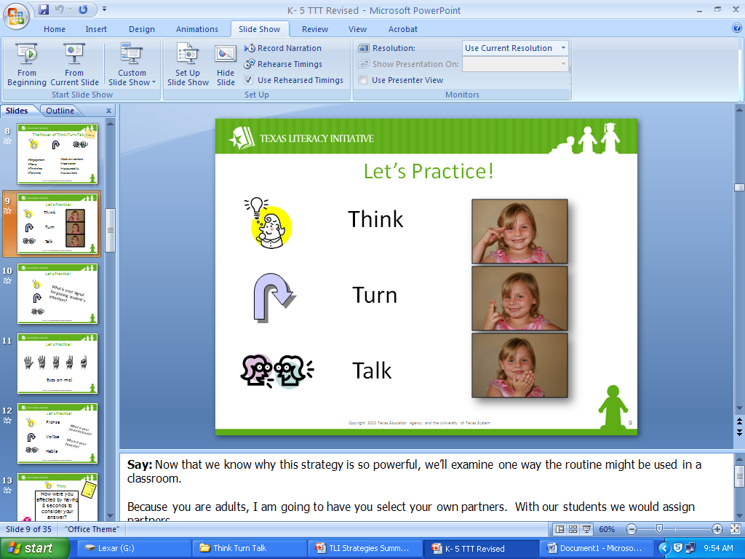
Think-Turn-Talk (PK – 5th)
3-5 seconds
time to process
thoughtful pairs
well-planned
questions
Notes:
This instructional routine should occur frequently throughout the school day and across content areas. Do NOT shorten the think time as it is a crucial component.
Refer to the ELAR/SLAR Instructional Guide for HMH TTT questions available for Kinder – 5th grade.
*Notes suggested –
Question: Why is it important to use the think-turn-talk routine?
- It helps students anchor what they have just read.
- It helps the students verbalize what they are thinking.
- The teacher can check for understanding.

Slide 8

The Power of Think-Turn-Talk
  Engagement
  Focus
  Think-time
  Talk-time
  Safe environment
  Application
  Accountability
  Assessment
Notes:
This instructional routine provides an opportunity for all students to process, engage and participate verbally.
“If you want them to HEAR it, you talk. If you want them to LEARN it, they talk.” Sharon Bowman(2005)
Talk time is important for oral language development. “Children who do not hear a lot of talk and who are not encouraged to talk themselves often have problems learning to read.: (Armbruster, Lehr, & Osborn, 2003)
Accountability: TTT also provides built-in accountability. The teacher asks three students to share their thinking with the whole class after they talk to their partners. Students are aware ahead of time that they will be accountable. Assessment: It is important for teachers to listen to the conversations and walk around to monitor. This give importance to the activity.

Slide 9
Tips and Tricks
Ask questions that involve critical thinking, opinion, or an extended answer.
Specific: “Why does the character …?”
General: “What are you thinking?”
Ask questions that relate to the CPQ
Ask questions that reinforce the cognitive strategy you are focusing on in the lesson
Write prompts on sticky notes and place them in your T.E. as reminders
Notes:
Be prepared ahead of time. Use sticky notes or some way to thoughtfully choose appropriate TTT stops.

Slide 10
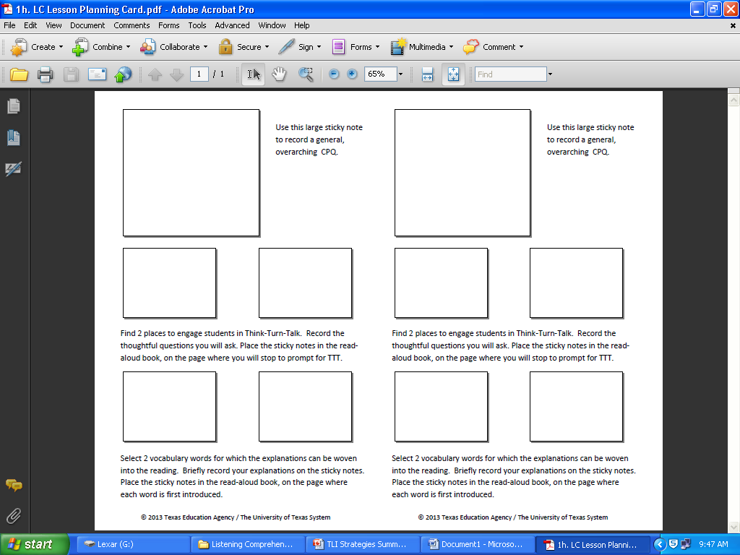
Listening Comprehension (PK – 2nd)
Read Aloud Everyday
Share Your Thinking
Make it Interactive
Build Vocabulary
Notes:
Read Aloud Everyday is NON-NEGOTIABLE. Listening comprehension has a positive effect on students’ story recall, word identification, and phonemic awareness.
During daily read-alouds we are laying the foundation for our students to be successful with reading comprehension.
Share Your Thinking: The teacher explicitly models the strategies we used for understanding text, making it visible to our students, by sharing our own thinking.
Making it Interactive: Students can repeat phrases, make hand gestures or engage in conversation.
Build Vocabulary: Previous to reading the teacher selects two vocabulary words to focus on more in depth. (refer to Listening Comprehension Planning Card)

Slide 11
Why Focus on Listening Comprehension?
  Reading aloud helps students to:
  realize that reading is pleasurable
  make connections between words and how they sound
  learn concepts about print
  expand vocabulary
  learn about people, places, and things they haven’t experienced firsthand
  understand the reading process
  hear what smooth, phrased reading sounds like
  develop an understanding of various text structures
  learn comprehension strategies that good readers use
Notes:
When we read aloud to students we can expect the following:

Slide 12
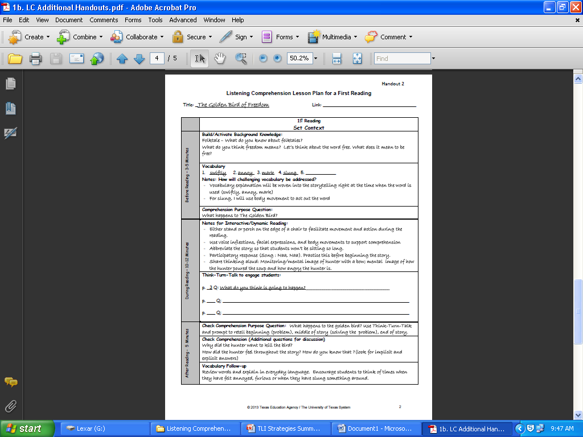
Rich Explanations of Vocabulary Words
  Point to the illustration
  Provide a definition using language that students understand
  Use a synonym
  Use a gesture or tone of voice
  Use the word in a new context
  Ask students to apply the word to a context they know
  (Archer, 2008; Beck, McKeown & Kucan, 2002; National Reading Panel Report, 2000)A
Notes:
The National Reading Panel (NRP) report explains that students need multiple, repeated exposures to vocabulary if we are to see learning gains. These are some ideas for enriching the students’ vocabulary and to make it more meaningful to them.
*Notes suggested
We need to show students that reading is active.
There are 4 levels of language acquisition. Speak, Listen, Comprehension, and Critical Thinking.
Darcy Dycha: LC is one of the best predictors of reading comprehension. It helps develop PA skills.

Slide 13
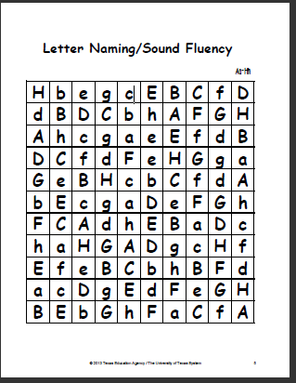
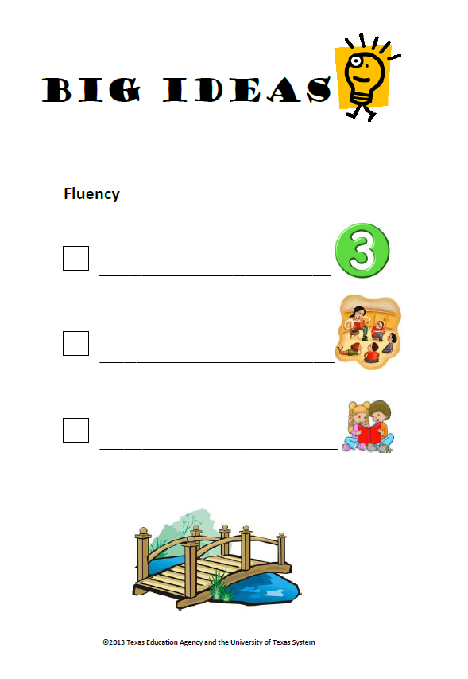
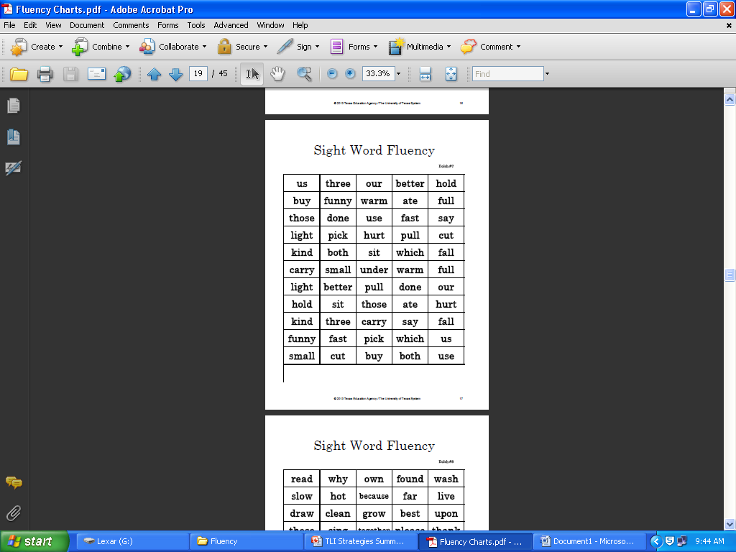
Fluency (PK – 2nd)
Fluency= Accuracy,
Rate & Prosody
Model fluent reading
Opportunities for oral reading practice
Notes:
The BISD Fluency Initiative was implemented districtwide during the 2013-2014 school year for Elementary, Middle School and High School.
Reading fluency is the bridge between the two major components of reading which are word decoding and comprehension.
As with all good teaching we want to model for students what we expect them to do.
In order for students to improve their oral reading fluency, we need to provide multiple opportunities for them to practice.
Refer to the fluency packets including letter naming fluency, high-frequency word fluency and phrases as well as passages.

Slide 14
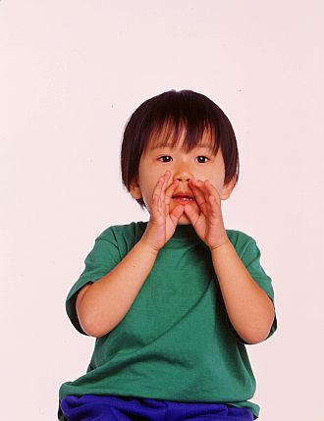

Ways to Build Reading Fluency
Effectively model fluent reading
Provide oral support of student reading through structured oral reading practice
Offer multiple opportunities for practice
Encourage fluency through phrasing
Echo reading
Choral reading
Paired reading
Notes:
In order to model fluent reading the teacher needs to read with expression and enthusiasm! Use inflection, voice and emotion.
Three of the ways teachers can effectively model fluent reading is through echo reading, choral reading, and paired reading.
Echo Reading: Teacher reads one sentence at a time, students listen, teacher gives the signal, students read the same phrase chorally.
Choral Reading: Teacher gives a signal to begin, students and teacher read together orally.
Paired Reading: Teacher assigns reading partners, students take turns reading, teacher monitors and gives corrective feedback

Slide 15

Fluency: Non-Examples
Robot Reading: Students read without expression
Race Car Reading: Students attempt to read as quickly as possible
Stop-and-Go Reading: Students stop when they come to a word they don’t know and wait for someone to tell them the word
Slow-and-Steady Reading: Students read at a slow, steady rate for the entire passage
Notes:
Following the District Fluency Initiative the teacher will model the use of punctuation stops (highlighted) and phrasing (pencil swings) to help students achieve reading fluency with accuracy and prosody.
*Notes suggested –
Early childhood teachers use poster size to review whole group.
Pre-K fluency vocabulary cards to identify pictures, letters, numbers, and shapes.

Slide 16
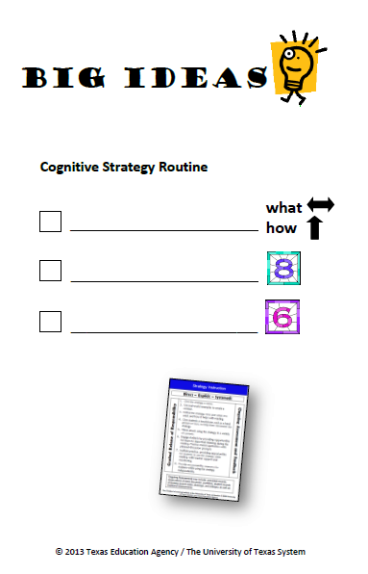
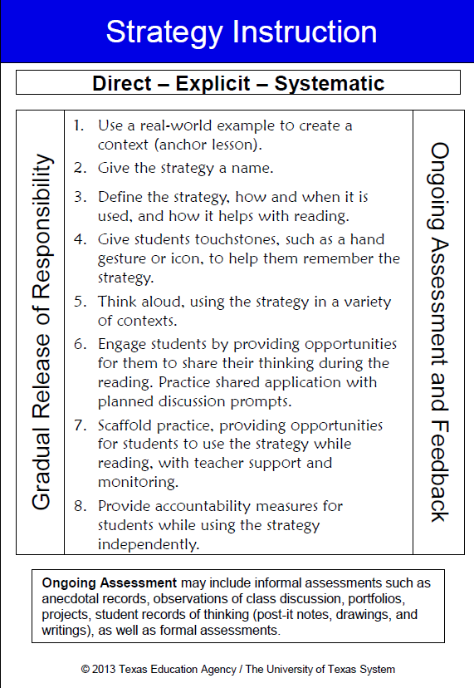
Cognitive Strategy Routine (K-5th)
Consistent Routine
8 Step Routine
6 Cognitive Strategies
Notes:
Focus on the blue strategy instruction card. It must be Direct-Explicit- and Systematic Instruction.
Big Ideas:
Consistent Routine
8 step routine
6 cognitive strategies
CSR card: one side 8 steps / back cognitive strategies with the definitions.
This card is used to introduce & teach the strategies.

Slide 17


Cognitive Strategies
Making Inferences & Predictions
Determining Importance & Summarizing
Monitoring & Clarifying
Making Connections
Asking & Answering Questions
Creating Mental Images
17
Notes:
Four out of these six cognitive strategy routines have been introduced in the following order:
Making Connections, Creating Mental Images, Making Inferences and Predictions and Determining Importance and Summarizing.
This school year will be dedicated to the refinement and implementation with fidelity through planning and coaching support.
Display the posters with Figure 19 TEKS.

Slide 18
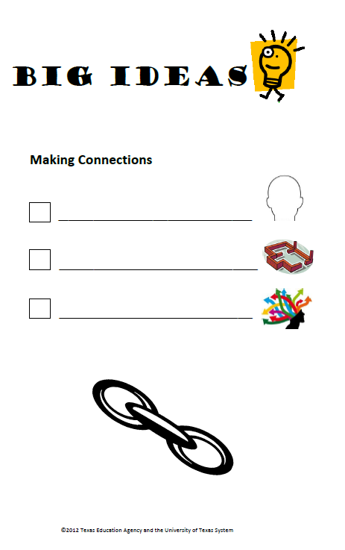
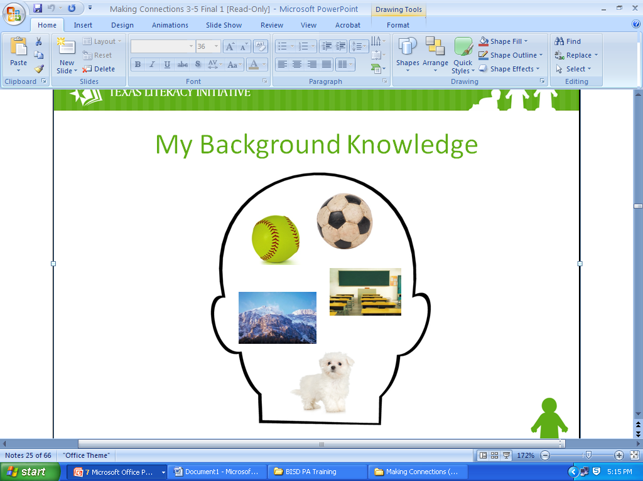
Making Connections (K-5th)
Anchor Lesson
Activate/build
background knowledge
Making Connections =
foundational strategy
Understand
distracting connections
Notes:
As teachers, we can introduce text to students in a way that helps to activate readers’ background knowledge to aid comprehension.
Good readers make connections between text and their background knowledge to help them understand and remember the text better.
Distracting connections actually cause our minds to wander from the text and disrupt meaning…ex. “That character has the same name that I do!” “ That character has a dog, and I have a dog, and one time we took the dog to the lake. We went fishing at the lake. We ate the fish for dinner. I don’t like fish. I like pizza.”
Anchor Lesson Activity: (see insert) It is a wonderful activity for the beginning of the year. Encourage students to create their own poster on the head template to represent their background knowledge. This activity validates their individual knowledge as important.

Slide 19
Build? Or Activate?
Building Background Knowledge
Students know little or nothing about a topic
May take place 1-2 weeks before reading
Takes 3-4 exposures, no more than 2 days apart
Activating Background Knowledge
Students have some knowledge of a topic
Takes place directly prior to reading
Takes 2-10 minutes
Notes:
Teachers need to know the difference between these to maximize student understanding.
If students know a lot about dogs the knowledge will be activated but if they are unfamiliar with Antarctica that knowledge will have to be built.

Slide 20
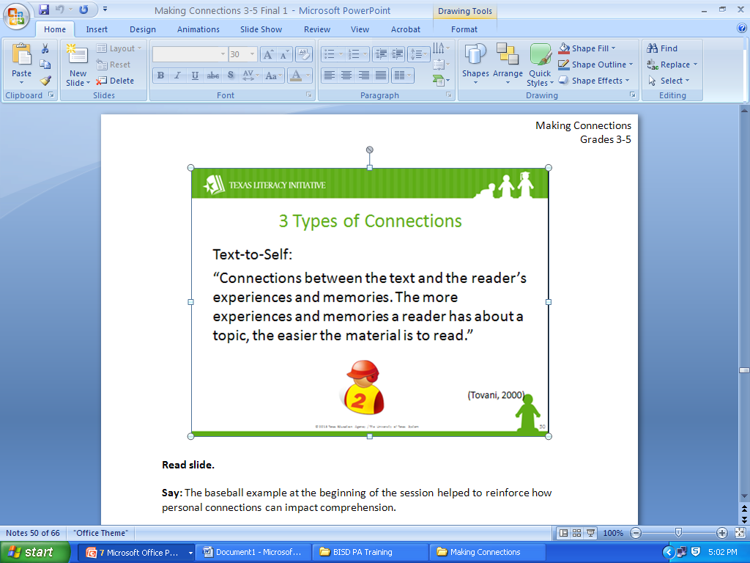
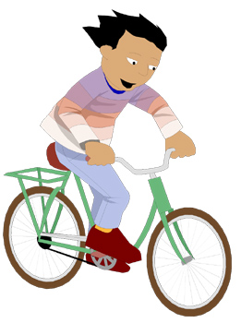

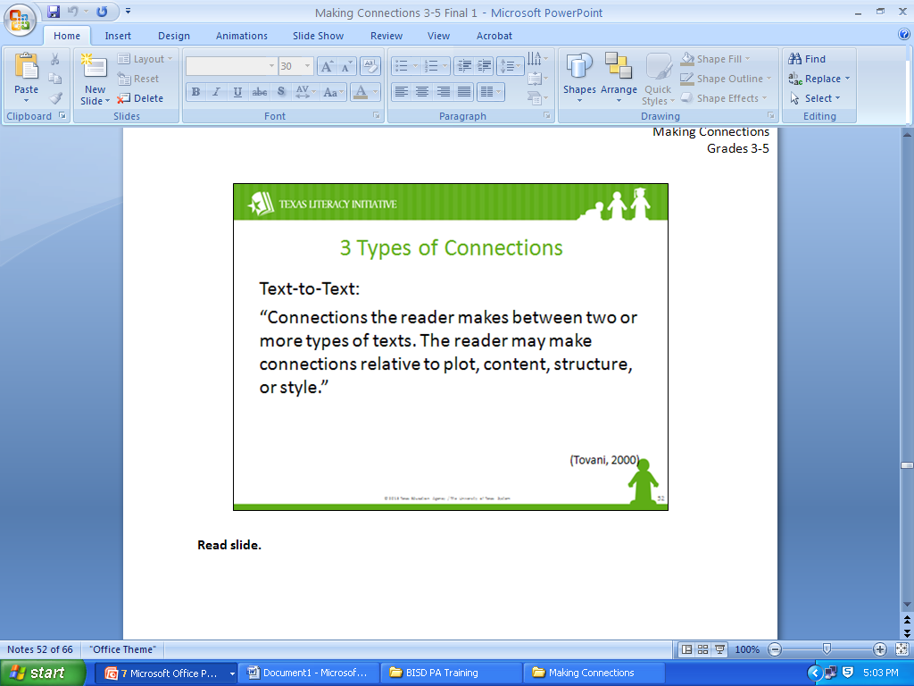

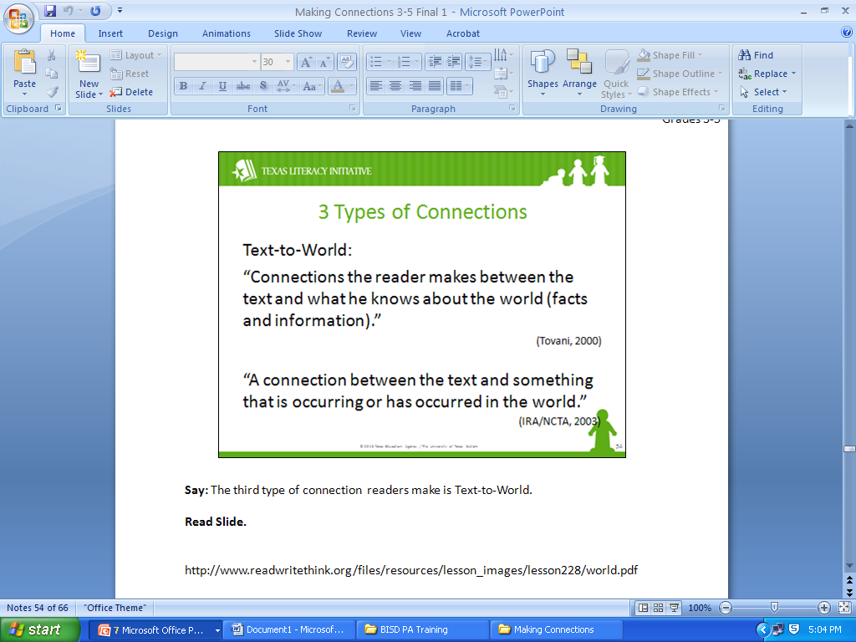
3 Types of Connections
Text-to-Self
Text-to-Text
Text-to-World
Notes:
When teaching Making Connections, the teacher should be
aware that there are three types of connections readers make
When reading a text. (Read Slide Notes)
*Notes suggested –
High School students can use movie maker to build their
knowledge.
Students read a book and the teacher makes connections
between the characters in a story and similar students within
the class.

Slide 21
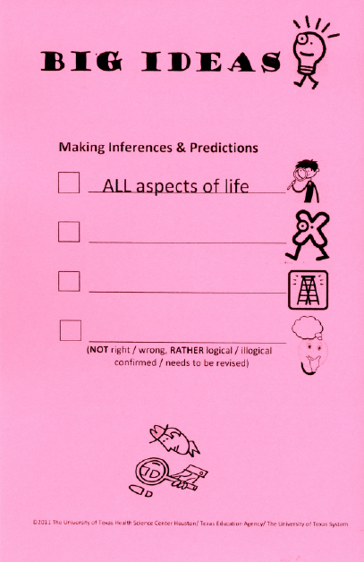
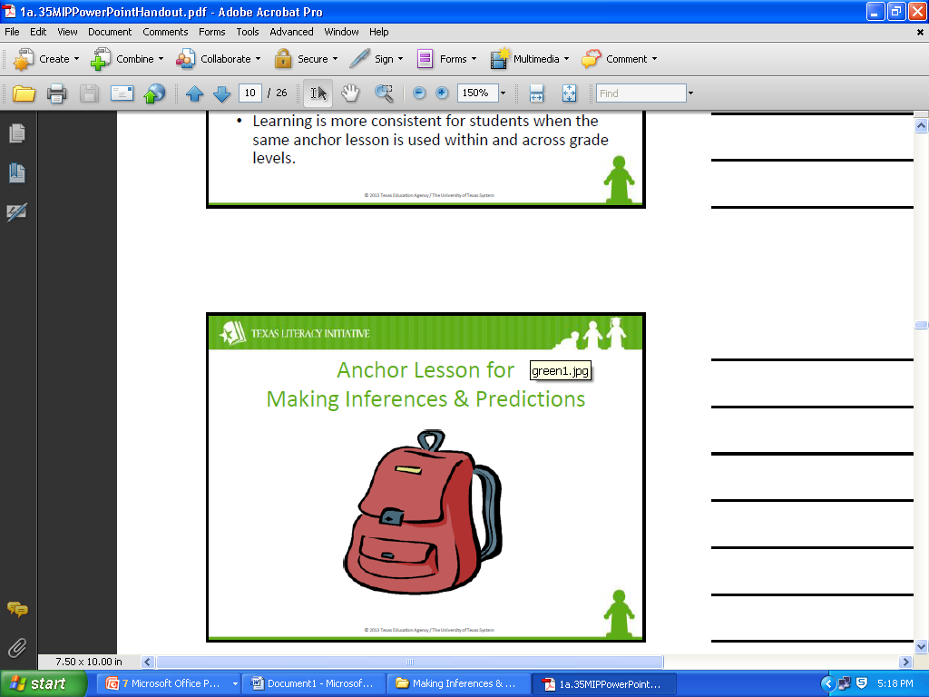
Making Inferences and Predictions
(K – 5th)
Anchor Lesson
Making Inferences & Predictions
Explicit Instruction
Scaffold for Success
Across Content Areas
Notes:
Explicit instruction begins with an anchor lesson and strategy
instruction that follows a clear routine to set students up for
success.
The anchor lesson is the found backpack containing items as
clues to determine the owner.

Slide 22
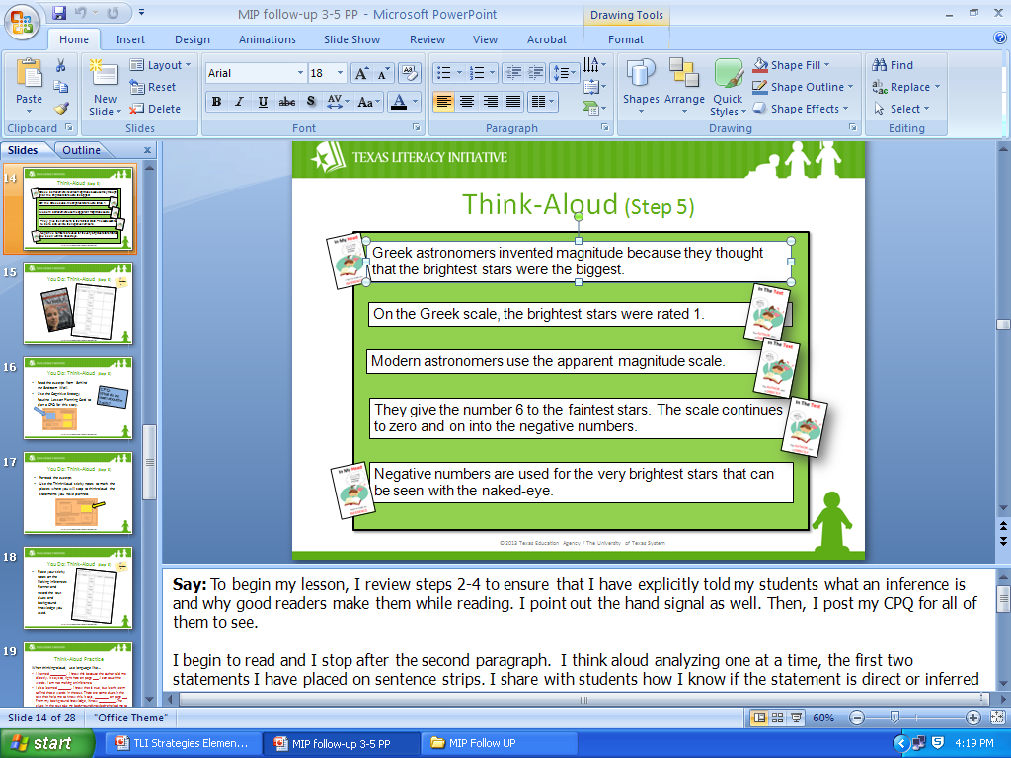
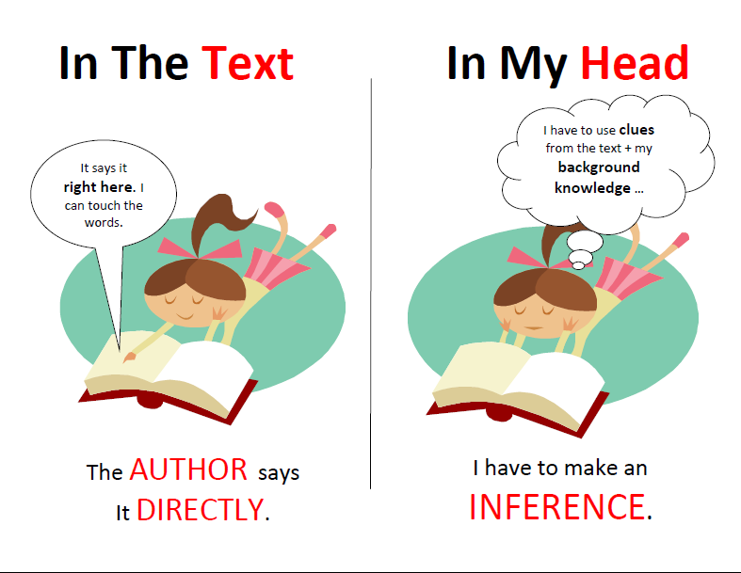
Step 5 - Think Alouds
Use scaffolds to
support student
learning
Notes:
Statements are determined to be in the text or have clues found
in the text. Use the “In my head, In the text” poster to guide
students with this strategy. Use the sentence strip activity to
model the strategy.
Refer to MIP statements for HMH stories 1st and 2nd grade found
in Literacy Curriculum Supports packet.
*Notes suggested - Think out loud questions are not questions
for your students. The teacher asks a question and thinks out
loud to answer the question.

Slide 23
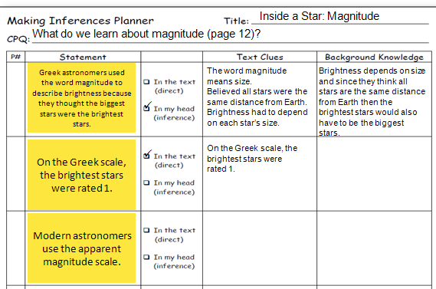
MIP Graphic Organizer
Notes:
This graphic organizer is used to model the implementation of
the strategy. This type of activity helps students to actively think
about the text while they are reading because it helps them to
explore a text by using explicit and implicit thinking processes.
It is a student centered strategy that allows the teacher to
guide children in making inferences. Refer to Literacy
Curriculum Supports packet.
*Notes suggested – A drawing of a backpack that leads the
teachers to believe that the backpack belongs to the principal.

Slide 24
Creating Mental Images (K – 5th)
Anchor Lesson
3-5 seconds
Creating Mental Images
time to process
Activate background knowledge
well-planned ?s
Understand text structures
Texts are memorable
Increase motivation
& engagement
Notes:
This strategy is sometimes called Visualizing or Imaging. It’s important to remember that when we Create Mental Images, we use all five of our senses and our emotions or feelings.
Anchor lesson: microwave popcorn

Slide 25
CMI with Literary Text
Focus on Creating Mental Images to…
Personalize a reading
Understand characters and their motivations
Experience action or events
Make the setting more concrete
Clarify the plot
Make inferences and predictions
Connect unfamiliar topics to familiar topics
Notes:
This skill is directly related to STAAR questioning. The teacher
explicitly models how to create a mental image to assist
students with comprehension on a deeper level.

Slide 26
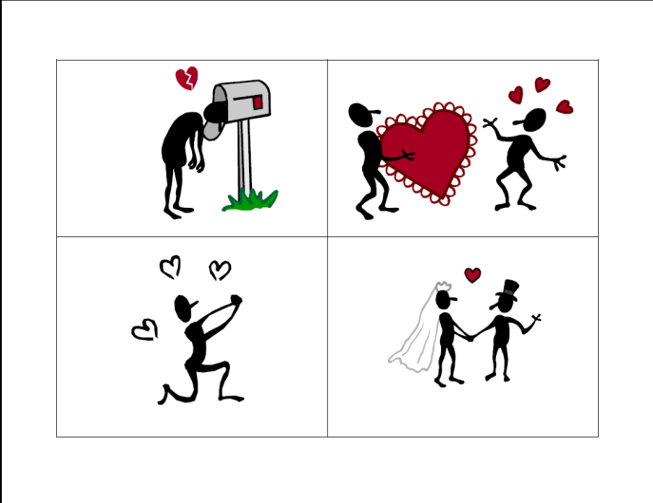
“Sketch It”
Play the game “sketch it”
Students fold paper into quarters
Teacher reads aloud for 1-2 minutes
Teacher stops and says “sketch it”
Teacher gives students 2 minutes to sketch their mental image in one quarter
The teacher repeats second-fourth bullets until all four quarters of the paper are finished
Notes:
This activity is very useful for use with all readers and
specifically reluctant readers. It provides the students direct
practice with creating mental images.
*Notes suggested –
Creating Mental Images is appropriate with poetry in the middle
and high school level.
Resource teachers can use this hands on and drawing approach.
Struggling readers need to stop and picture what they are
reading.

Slide 27

Determining Importance & Summarizing (K-5th)
Anchor Lesson
Determine Importance
& Summarizing
Select important information
as they read the text
Identify the topic & main ideas
Use graphic organizer to summarize
The lost dog poster
Notes:
Anchor Lesson: Lost dog poster The students select the most
important facts to include on the lost dog poster out of a longer
list.
Students learn to determine what information is important to
know and to remember after reading a text. District data shows
that this is one of the most challenging skills for students to
learn.
Refer to Literacy Curricular Supports lessons for 3rd, 4th & 5th
grade using NG Reach Expository Passages.

Slide 28
Topic, Main Idea or Summary?
Term | Definition | Example
Topic | Who or what the text is about; can often be expressed in one or two words. | Sharks
Main Idea | What the text says about the topic; can often be expressed in one sentence or less. | Sharks do many things.
Summary | A synthesis of the important ideas in a text; may be of varying length, expressed in the reader’s own words and should reflect the structure of the text. | Sharks swim through the oceans hunting for prey, such as fish and seals. Sometimes, they work together to attack prey and may even engage in playful activities.
Notes:
In order for teachers to explain DIS to students, they must
clarify the above three terms.
The state standards expect students to distinguish between
topic, main idea, and summary.

Slide 29
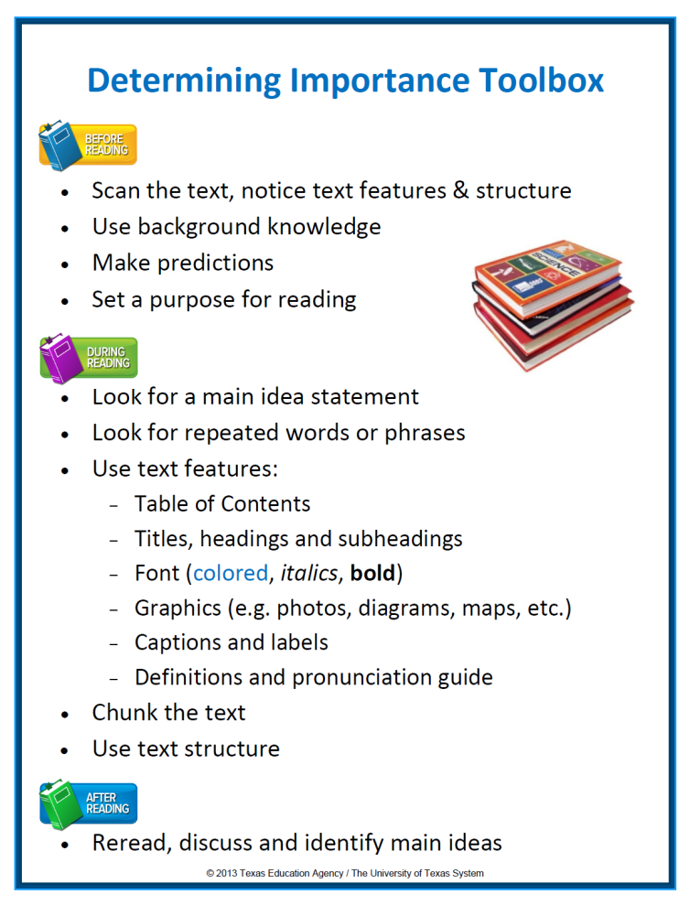
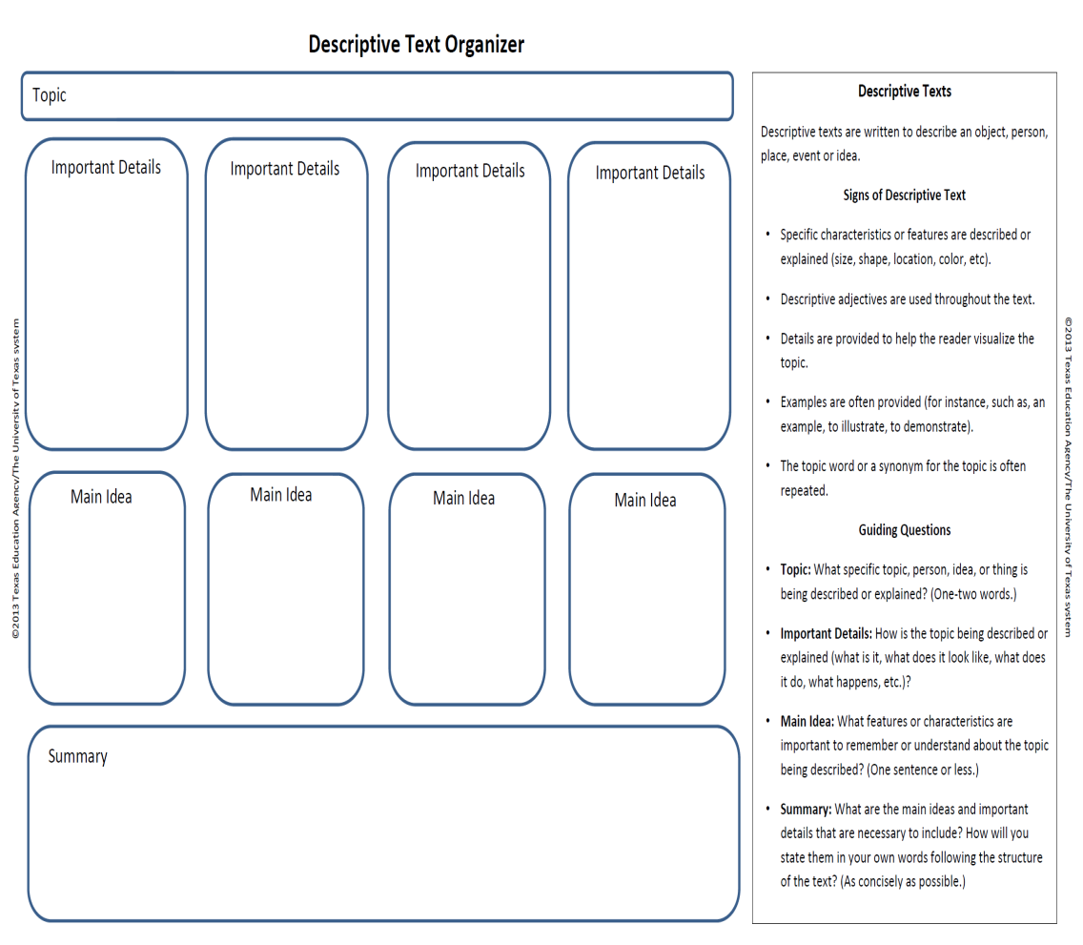
Descriptive Text Graphic Organizer
Notes:
The tool box contains the types of tools good readers rely on to
make sense of challenging informational text. There are steps
to follow Before, During and After reading a selection.
The Graphic Organizer: Passages are chunked according to new
topics. The important details are combined to make a main idea
and all the main ideas are combined to write the summary.
The key of this graphic organizer is to teach students the text
structure. This can be used to scaffold reading and to plan and
improve writing.
*Notes suggested –
Short passages work well for introducing the DIS lesson.
Annotation – it helps the students as they read the passages.
It is easy for students to comprehend the text better.

Slide 30
Other TLI Trainings
The TLI grant offers trainings on other topics focused on effective classroom instruction. These trainings are tools that teachers can use to enhance the literacy program.
Trainings | Planning for Instruction (PK)
Graphophonemic Knowledge Parts 1-3 (PK – 2nd) | Supporting Infant & Toddler Language Development and Literacy
Vocabulary & Oral Language Development (PK – 5th) | Building Language and Vocabulary through Themes
Phonological & Phonemic Awareness (PK – 2nd) | Using Data to Guide Instruction Developing Voc. Using a Letter Wall
Vocabulary Development in Letter Walls (PK) | Maximizing small group instruction
Infant and Toddler Guidelines (0 – 3 yr olds) | Language Building Strategies
Connecting With Parents (0 – 3 yr olds) | Listening Comprehension & Fluency
Notes:
Power Points and handouts are available for these trainings to enhance Early Literacy Instruction.
*Notes Suggested:
Build language: Read Alouds, Role-plays, Nursery Rhymes, PA games
Circle Training – to provide support to teachers with activities
Pre-kinder Institute – August 11 – 12 for new PK teachers

Slide 31
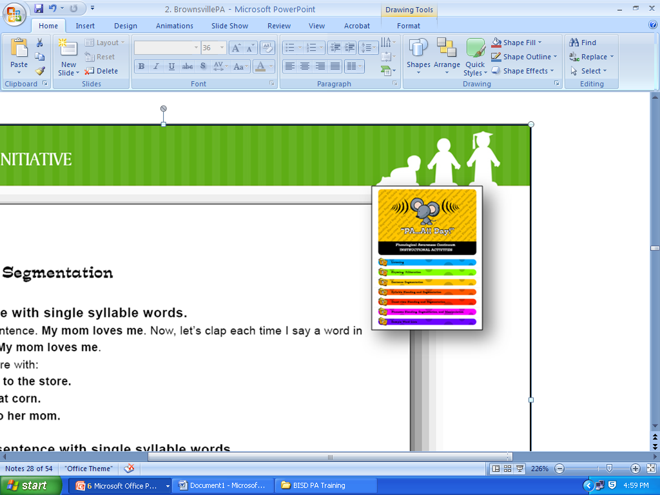
Phonological and Phonemic Awareness (PK-2nd)
PA all day!
Explicit Systematic Instruction
Consistent Instructional Scaffolds
Reinforce Phonological Awareness
Notes:
PA all day! and ¡Fonología todo el día! must be used daily, explicitly and
systematically to help implement effective PA instruction across the
district. It is available for free download on the Children’s Learning
Institute website. These activities can be used during whole group, small
group and transition times throughout the day.
Phonological Awareness is the umbrella that includes Phonemic
Awareness. Phonemic Awareness focuses on the individual sounds in
spoken language. It is the understanding that words are made up of a
combination of these speech sounds and the ability to identify each of
the sounds (or phonemes) in a word which is phoneme blending,
segmentation and manipulation.

Slide 32
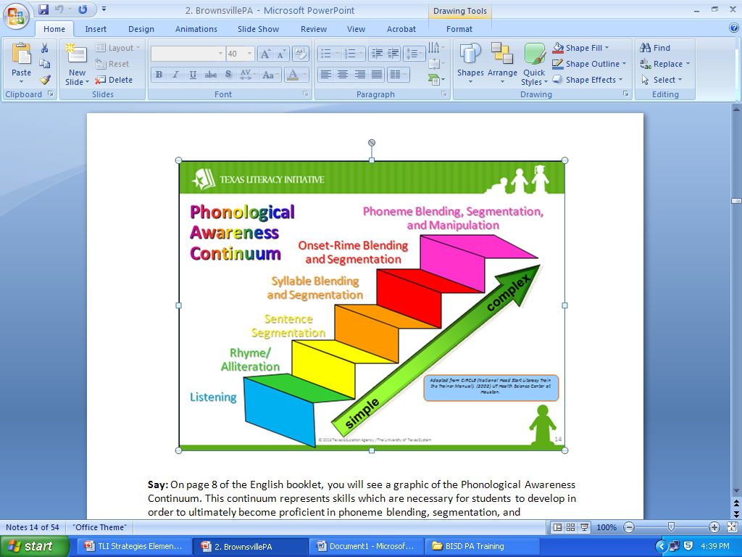
PA all day!
Notes:
This Phonological Awareness Continuum represents skills which
are necessary for students to develop in order to become
proficient in phoneme blending, segmentation and
manipulation. The skills are taught from simple to complex.

Slide 33
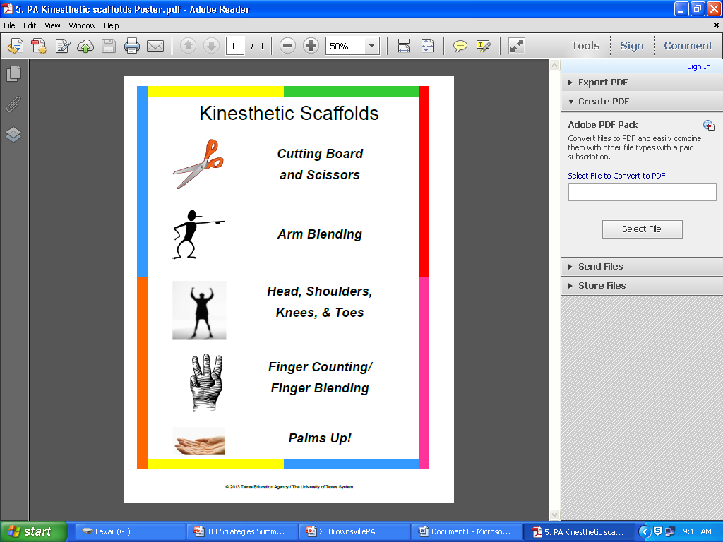
PA all day!
Use these scaffold routines to enhance
the daily Phonological Awareness activities
in your classroom.
Notes:
These scaffolds work well to help visually and physically
demonstrate the auditory task of blending and segmenting.
Notes Suggested:
PA all day! Resource that other teachers can use in the campus
to help out with PA. Librarians, Music teachers, PE teachers,
etc.

Slide 34
Graphophonemic Knowledge (PK-2nd)
      direct instruction
+
phonics activity
+
    daily dictation
=
An effective spelling routine!
A
It’s as easy as. . .
B
C
Notes:
This is an effective spelling routine that correlates to Reading. If
the students can spell, they can read.
Refer to Curricular Supports for GK/Spelling & HMH Scope &
Sequence. Spelling lessons have been created by grade level to
enhance the students’ spelling skills.
GK Lesson Plans have been developed for Kinder to 2nd grade
students for the 1st Six Weeks.

Slide 35
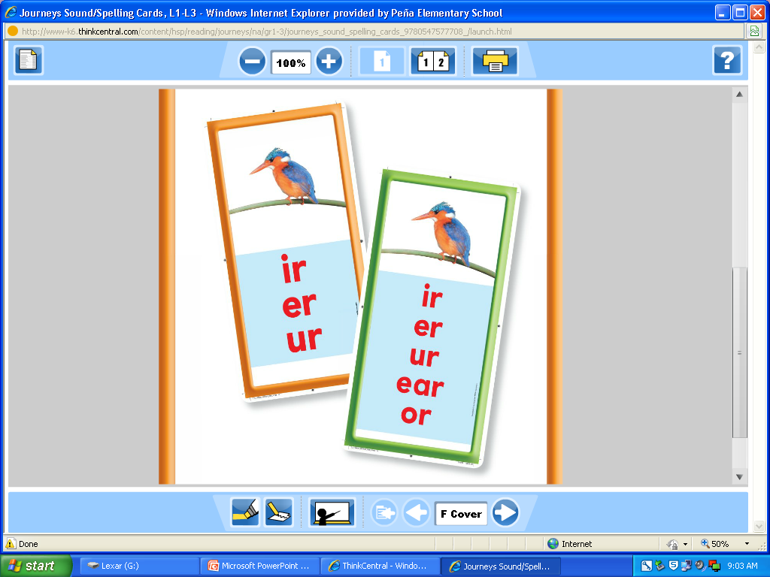
Graphophonemic Knowledge (PK-2nd)
Direct instruction, including think-aloud:
  3-5 minutes (reviews take a little less time)
  ONE phonics activity (whole group):
  5-7 minutes
  SHORT dictation—5 minutes
    5 letter-sounds
    2 letter-sounds, one word
    five words
    3 words, one sentence
Notes:
HMH Sound Spelling cards have been provided for Kinder, 1st
and 2nd grade classrooms. They are used for instruction and as
a scaffold for students and must be displayed at all times.
Dictation activities are not considered to be a Spelling test but
rather part of on-going instruction.

Slide 36
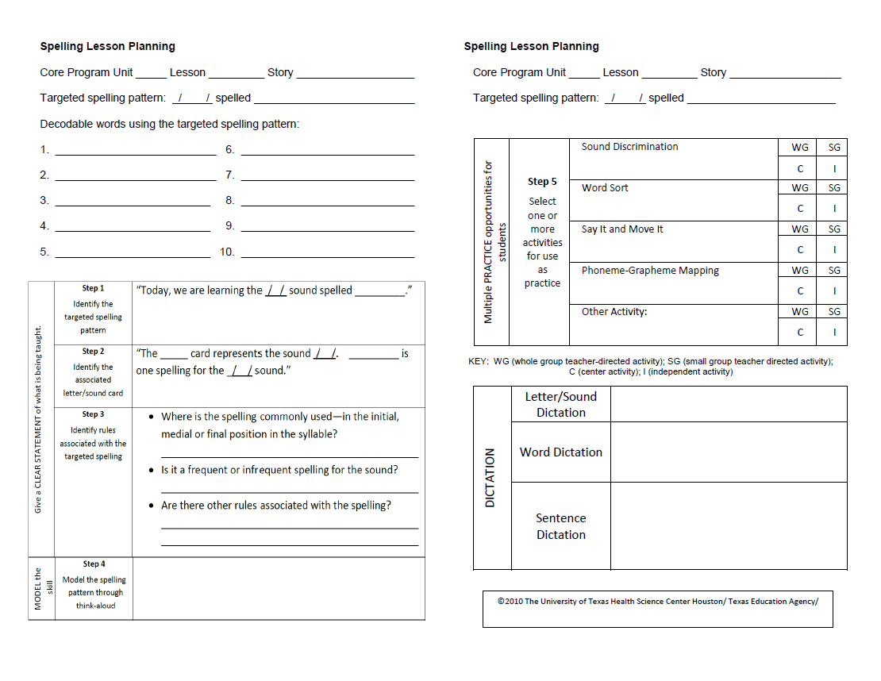
GK / Spelling Lesson Plan
Notes:
Refer to Curricular Supports GK/Spelling lessons developed by TLI
Teacher Specialists for Kinder, 1st and 2nd grade.
Lesson plan – 20 words for teachers to use, spelling pattern, explicit
routine (teacher script), multiple practice activities, dictation.
Notes Suggested:
GK Lessons are correlated with the HMH Scope and Sequence.
Do we follow the LE sequence or the HMH sequence? Both have to be
implemented.
Language Enrichment – teaches to break up a word through syllable types
(close syllable, open syllable). Do not teach it out of sequence.
GK Lessons – teaches the students how to spell words, by learning
spelling patterns.
Reading Rules Lessons – the students enjoy using the slinky to read the
word.

Slide 37
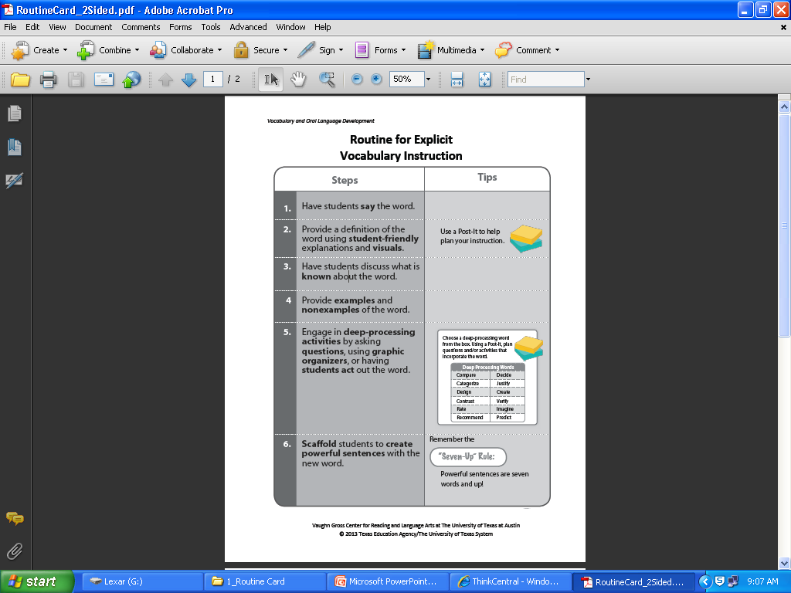
Vocabulary & Oral Language Development (PK – 5th)
Vocabulary Development
Improves comprehension & fluency
Direct instruction & scaffolding
Planning Effective Vocabulary Instruction: before, during, after
Notes:
Follow the BISD vocabulary initiative to promote the use of word of the week, cognates, student friendly definitions and multiple opportunities to use vocabulary.
The Routine for Explicit Vocabulary Instruction (see insert) is the foundation for the District Vocabulary Initiative.
Refer to Vocabulary Initiative: Supporting Resources & Literacy Curricular Supports Tier 2 HMH vocabulary scripts for Kinder, 1st, 2nd, 3rd, 4th, and 5th grade lessons.

Slide 38
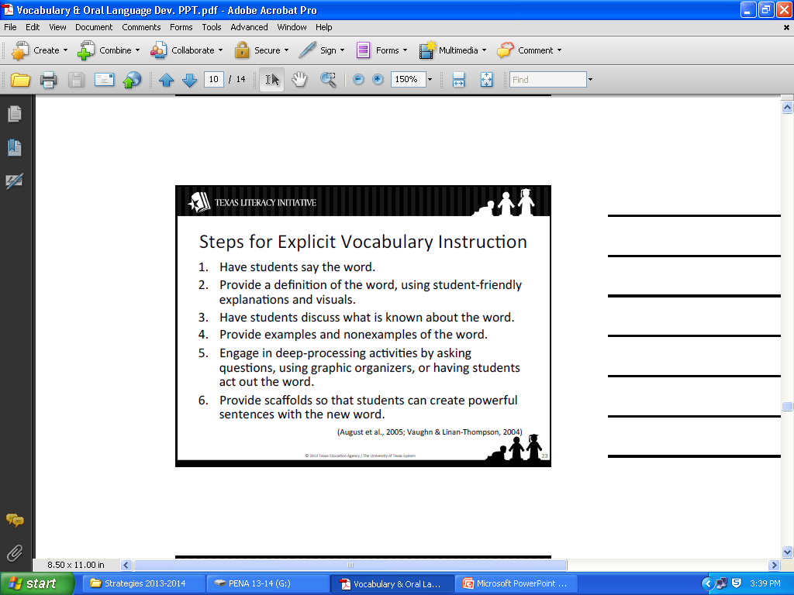
Vocabulary Instruction Routine
Notes:
The following steps are to be done consistently to maximize
students’ knowledge of academic vocabulary.

Slide 39
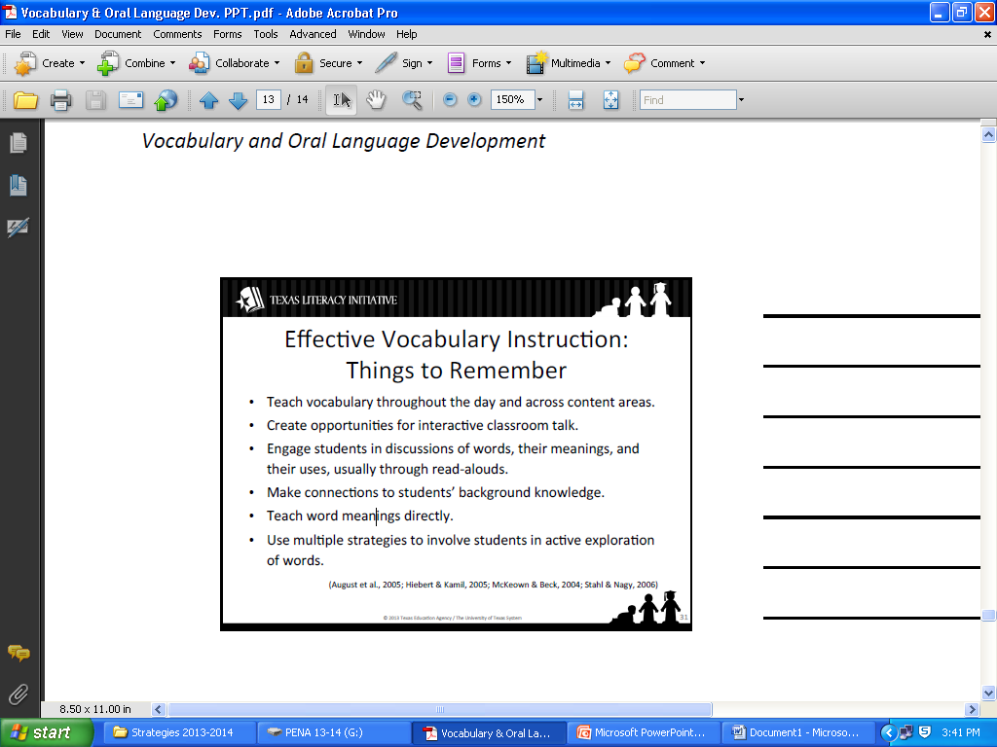
Effective Vocabulary Instruction
Notes:
Remember the following steps when teaching vocabulary:
Notes Suggested:
Cognates – useful for the students to acquire the 2nd language.
Middle School – focused on processing words, higher level
words.
Vocabulary Project – Teachers (Porter Literacy Line) worked on
the Tier the words for all the HMH Lessons 1st – 5th grade.
They followed the Vocabulary Initiative Routine to develop the
script to teach the words with pictures.

Slide 40
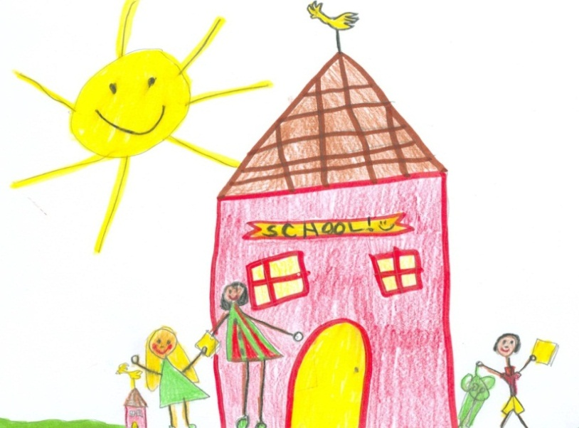
“The TLI Teacher Specialists will continue to support you
through coaching and modeling.”
Notes:
Middle School & High School Notes:
High School teachers, aware of the content, students struggle to
comprehend the content.
Vocabulary Initiative implemented throughout content areas.
Sketch it & Chunking activities are very helpful for students to
gain comprehension skills.

